Slide 1
Fundamental Training academy
Fta
“More than a game.”

Slide 2
MY WHY
Rooted in Faith. Built on Mentorship. Dedicated to Community.
Born and raised on the South Side of Chicago, I learned early the power of faith, family, and community. After my father’s passing in 1967, my mother, four older sisters, and younger brother held our family together in the Morgan Park neighborhood.
Mount Calvary Church became our foundation — a place where male mentors poured into my life, teaching me values, responsibility, and the belief that God has a plan for each of us. Their guidance gave me a moral compass and a sense of purpose that has carried me ever since.
From middle school through high school, mentors shaped every step of my journey — academically, athletically, and spiritually. Coach Barry at Gresham Elementary recognized potential I didn’t yet see in myself and helped open the door to opportunity. Later, at Morgan Park High School, Coach Warden encouraged me to pursue basketball — a path that changed the direction of my life.
Each mentor — teacher, coach, or community leader — helped me grow not just as an athlete, but as a young man learning how to lead, serve, and persevere. Their investment in me led to championships, All-American honors, and scholarship offers from across the country. But more than that, it gave me a vision for what’s possible when a young person has support, structure, and belief behind them.

Slide 3
Our Purpose
Our foundation exists to give back what was given to me — to create mentorship, leadership, and development opportunities for student-athletes and young leaders across Chicago and beyond.
We focus on building character, confidence, and career readiness through sports, education, and community engagement.
By connecting youth with coaches, educators, and professionals who care, we aim to help every student-athlete discover their purpose, pursue their potential, and become leaders — both on and off the court.
Our Mission
To empower the next generation of student-athletes through mentorship, education, and faith-based guidance — helping them succeed athletically, academically, and personally.
Our Vision
A community where every young person has access to mentors, resources, and opportunities that allow them to dream big, work hard, and achieve excellence.

Slide 4
Goals and Objectives
Fundamental Training Academy (FTA), a 501c3, is an elite mobile training service teaching the fundamentals of basketball, promoting education and helping build positive self-esteem in boys and girls from Middle School through College Freshman.
FTA teaches all fundamental aspects of basketball nationally and internationally as well as video review sessions, strength and agility training for individual athletes and teams.
FTA future goals include; building covered, multi purpose basketball courts in Africa. Aiding student athletes in pursuing their educational and athletic opportunities in the united states as well as Europe.
FTA Symposium, for student athletes, topics include; de-escalating violence between law enforce and youth, NCAA Div one and two recruiting, NIL, sports agents, additional information on Trade Schools, i.e. plumbing, carpentry, IT, Automotive, engineering etc.
FTA plans to build on its core foundation adding a more diverse platform to include the education component STEM (Science, Technology, Engineering and Math), as well as, additional sports, arts and entertainment for our student athletes.
FTA continues investing and mentoring todays youth to become positive, strong, productive members of society.

Slide 5
Current Sponsors
Chicago Bulls
Millennium Promotional
Atlanta Hawks / Atlanta Dream
Gemini Foundation
Five Below
Kellanova
Police Athletic League (PAL) Orlando, Florida
VanPelt Mason Holdings, LLC.
Fleur De Lys Hotel, Dakar, Senegal
NBBC – Nick Boniface Basketball Club
AdventHealth formally Florida Hospital

Slide 6
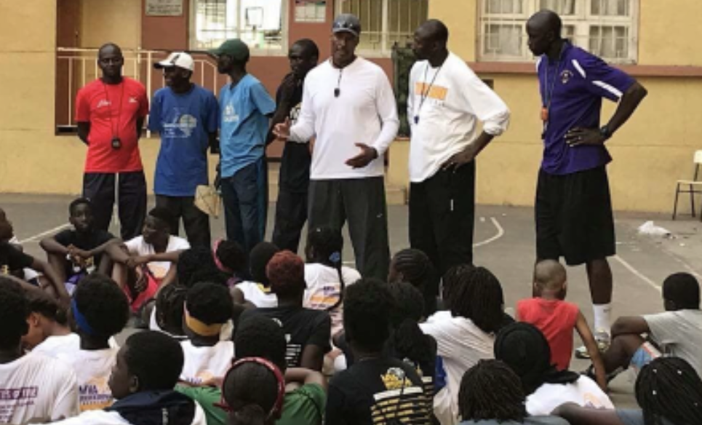
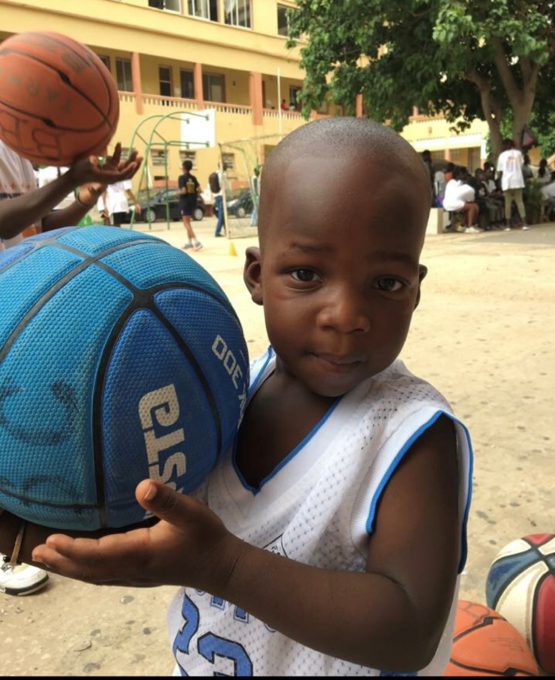
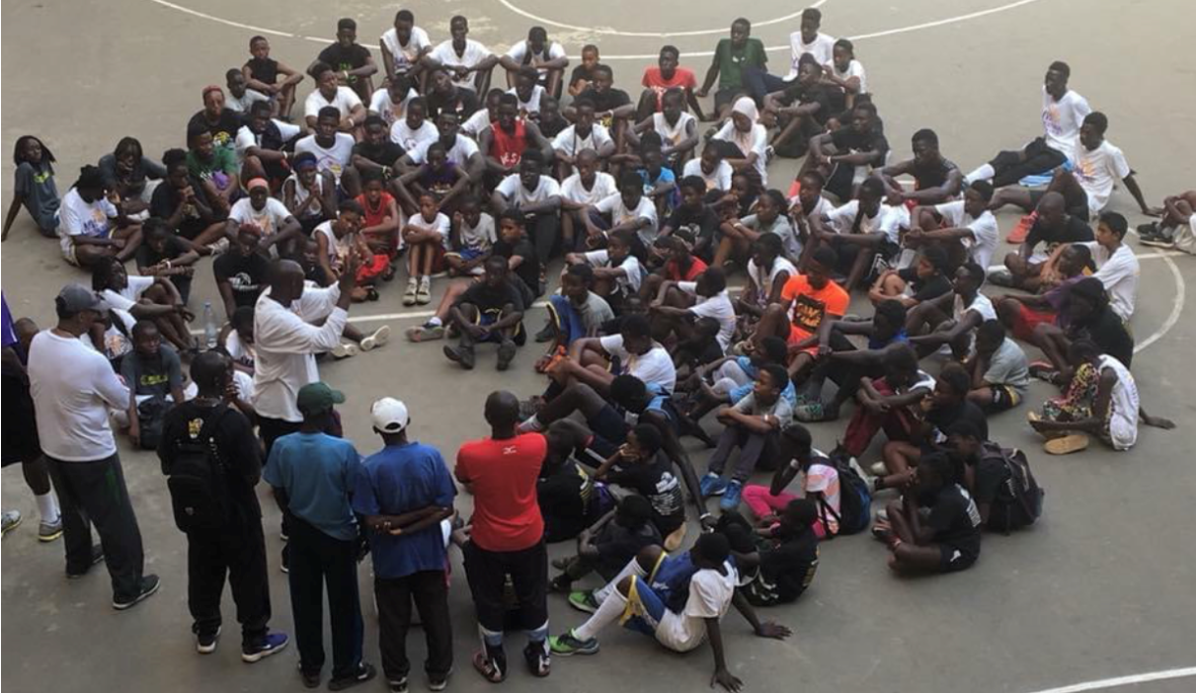
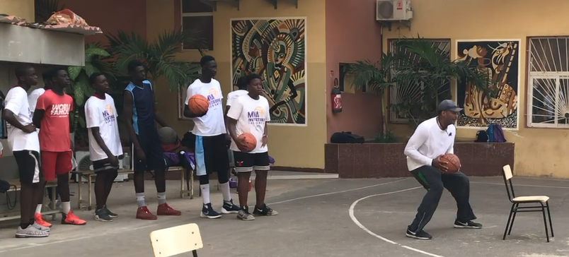
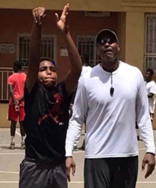
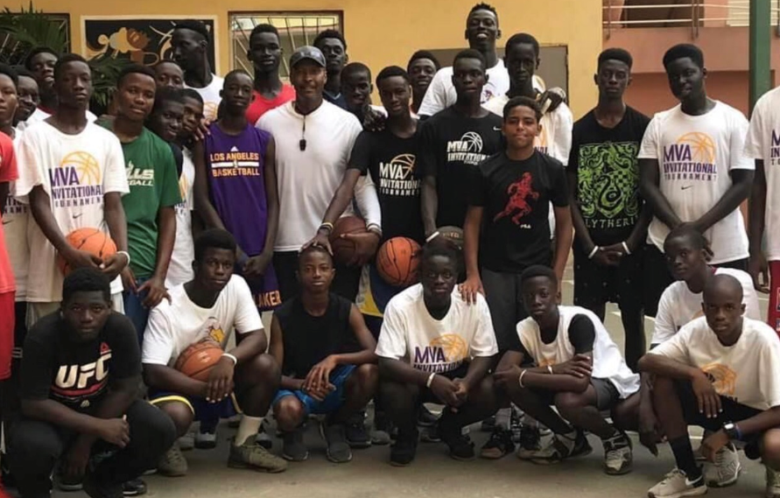
FTA International
Basketball Camps - Dakar, Senegal

Slide 7
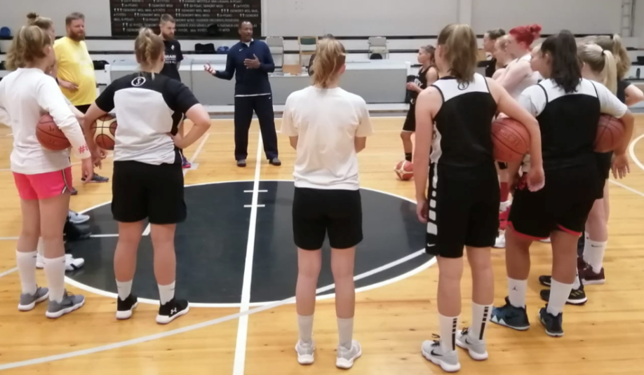
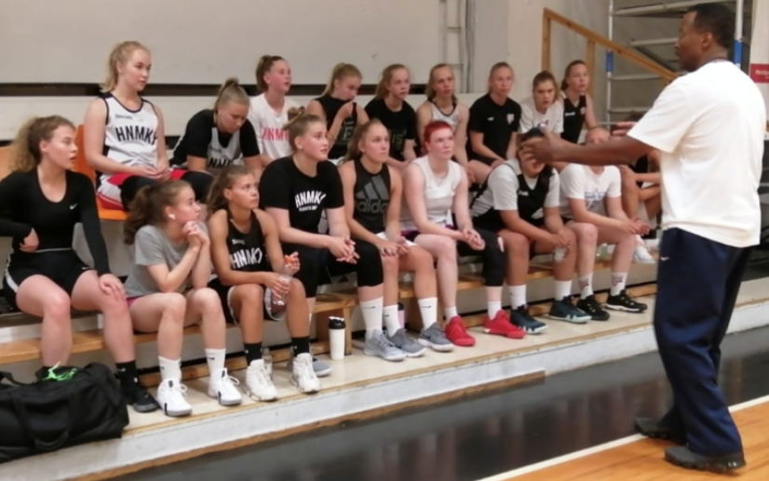
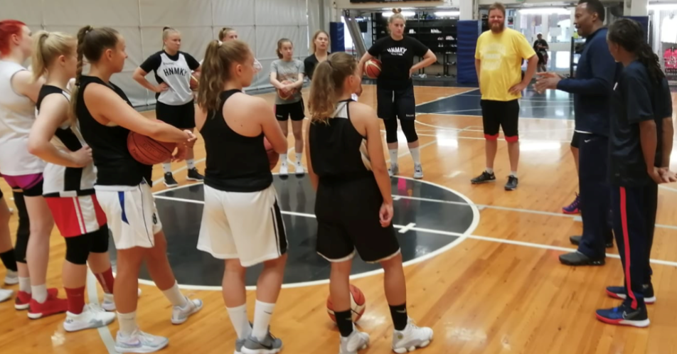
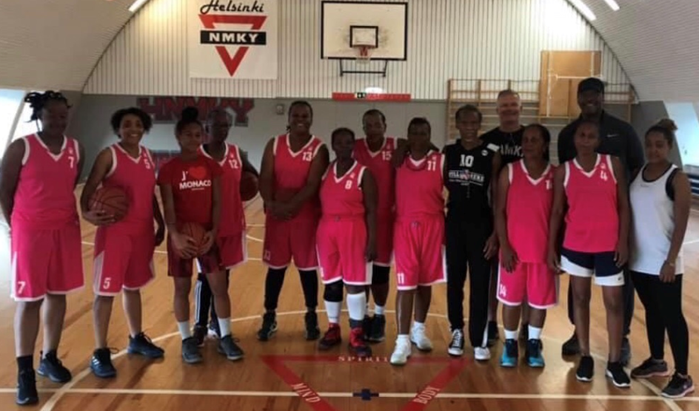
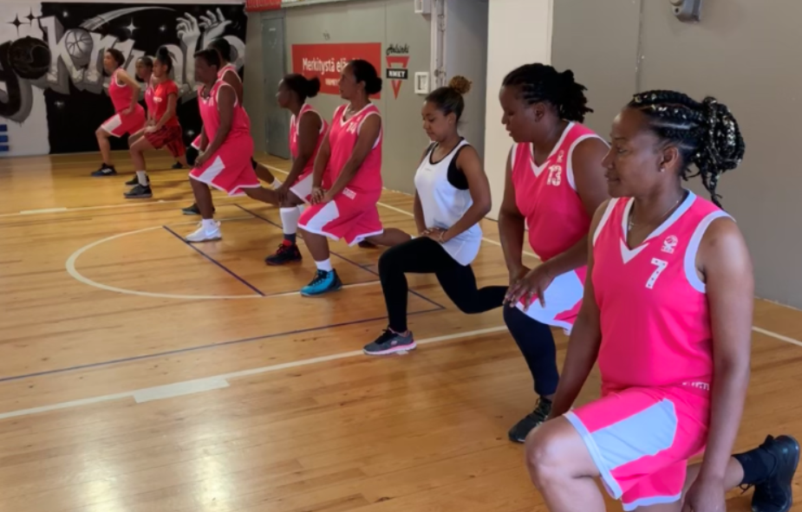
FTA International
YMCA Women's U18 - Helsinki, Finland
Guadeloupe Women’s Masters National Team - Helsinki, Finland

Slide 8
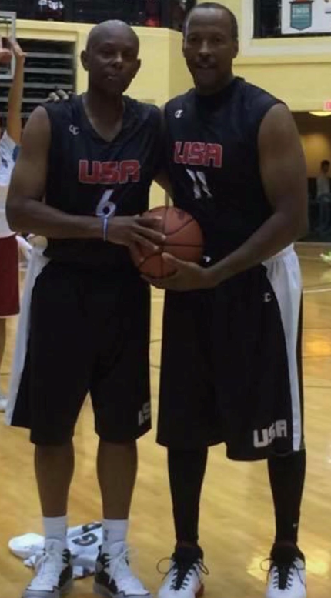
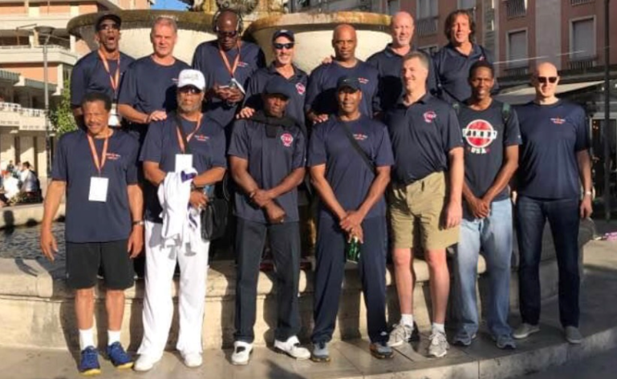
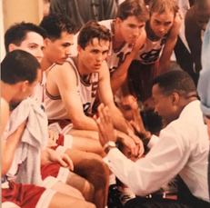
FTA International
World Masters USA Team Members - Montecatini, Italy
Head Coach - Queensland, Australia
USA World Masters – Orlando, FL

Slide 9
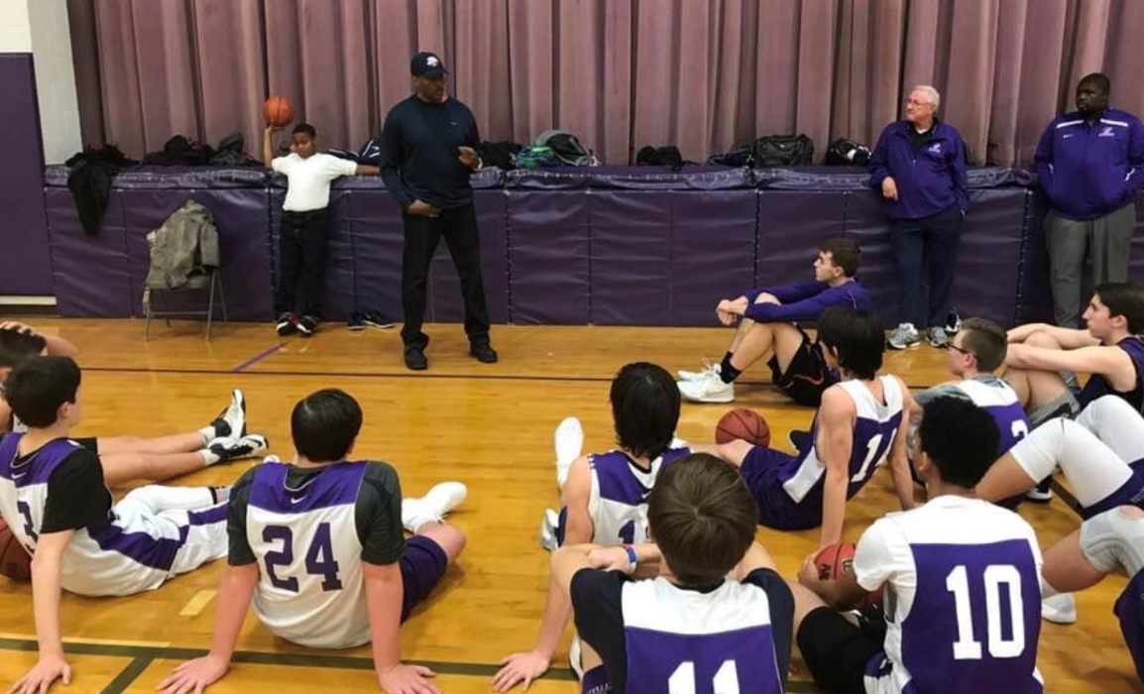
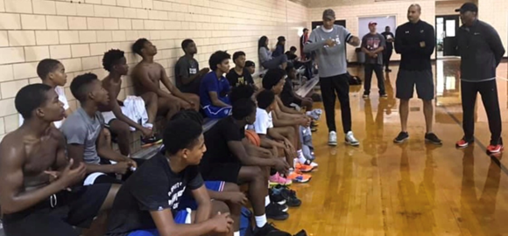
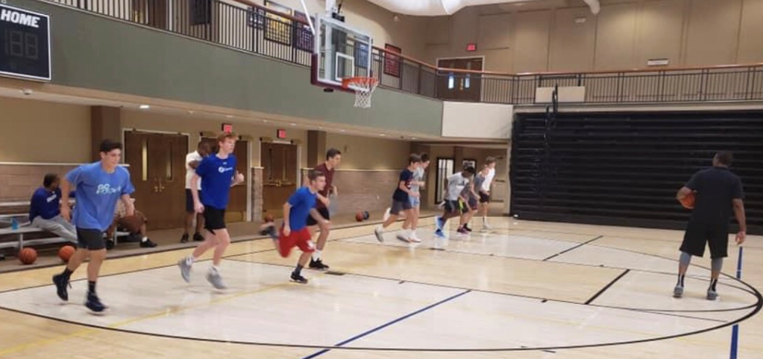
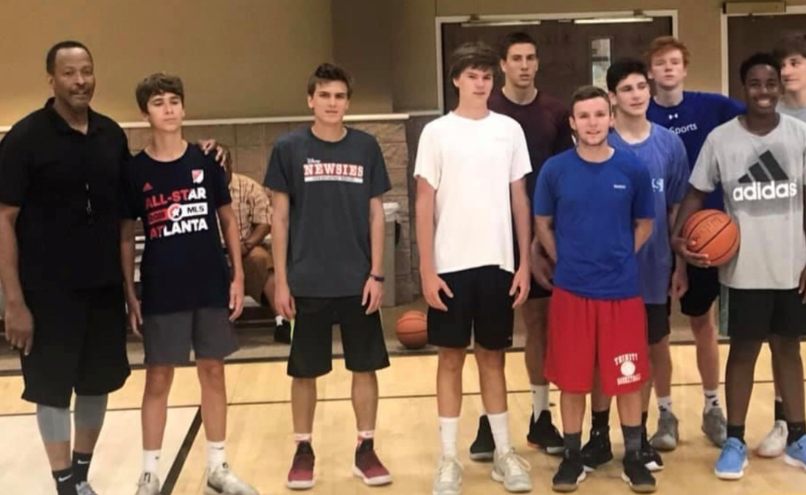
FTA National
Judah Christian High School - Champaign, IL
Sonny Parker Camp Washington Park - Chicago, IL
Johnson Ferry Christian Academy - Atlanta, GA

Slide 10
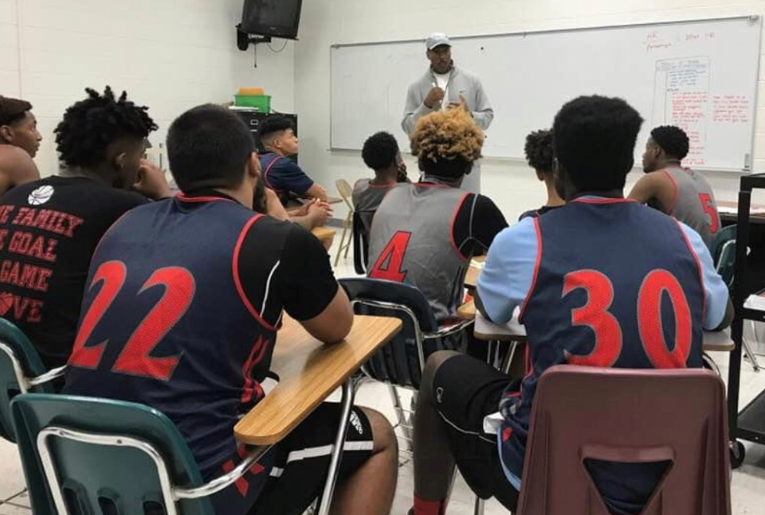
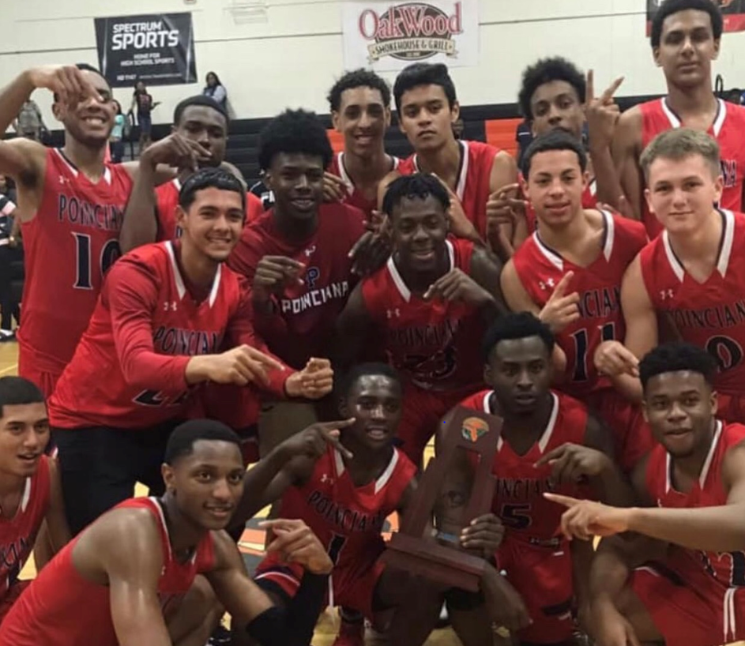
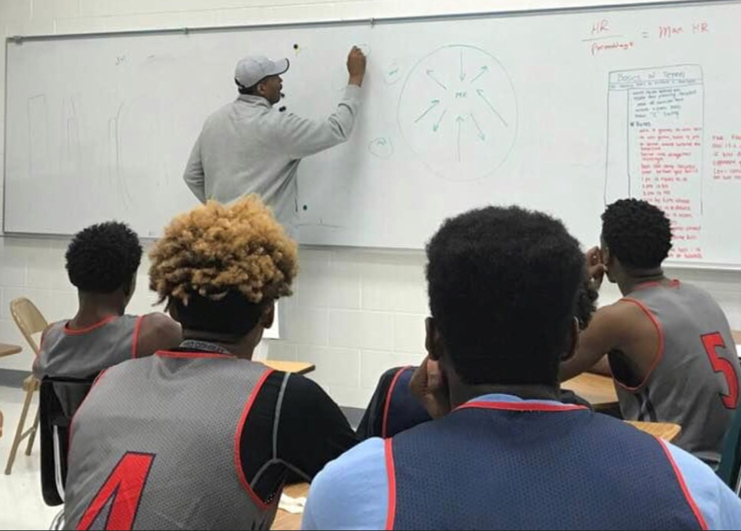
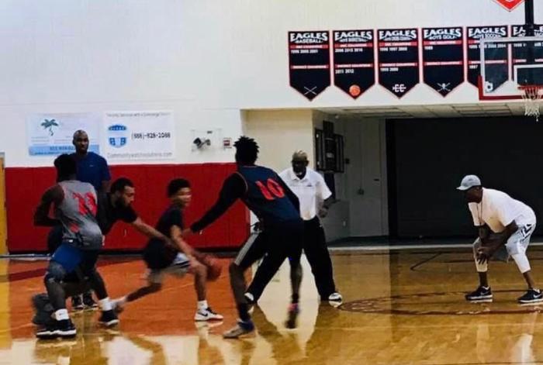
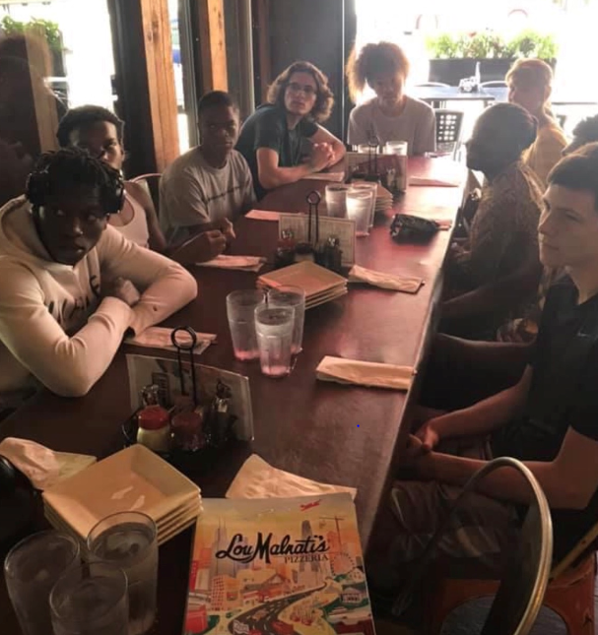
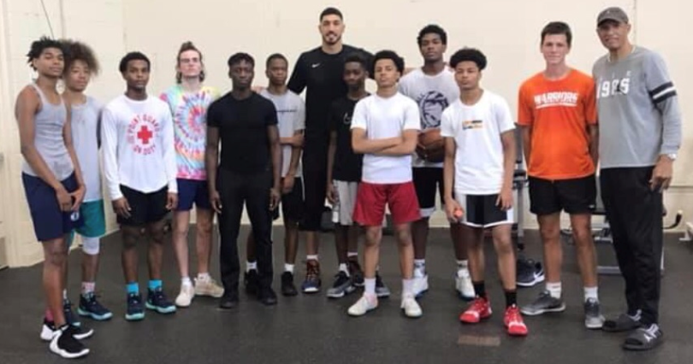
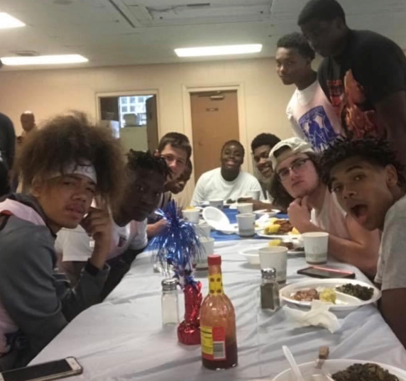
FTA National
Poinciana High School - Osceola, FL
West Orange High School in Chicago, IL

Slide 11
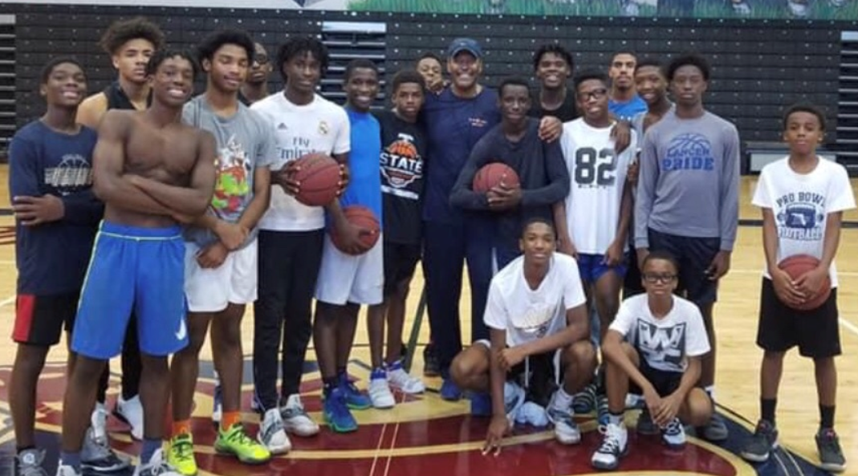
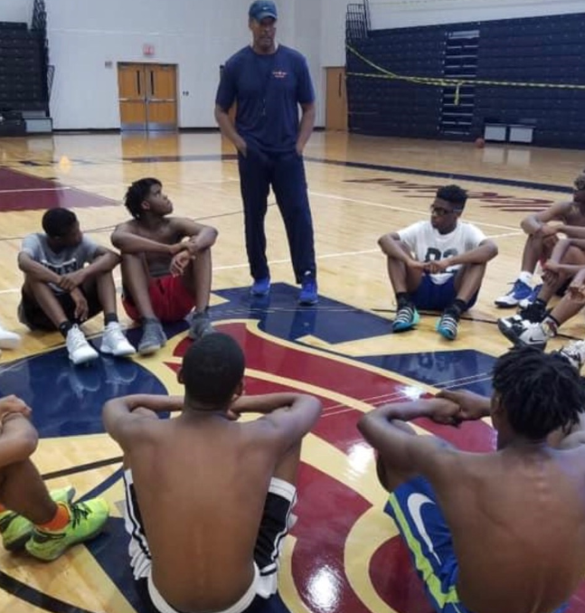
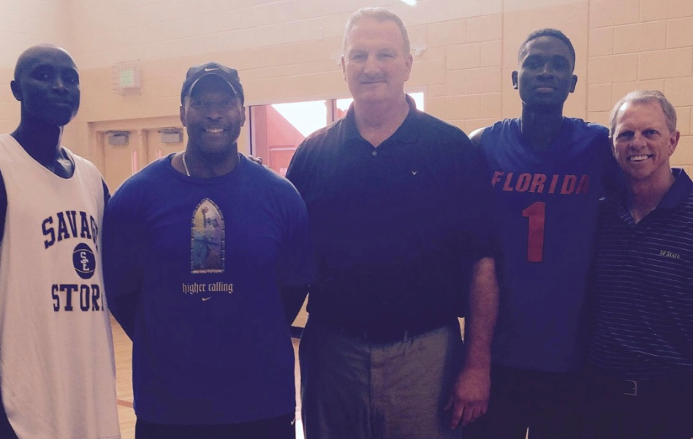
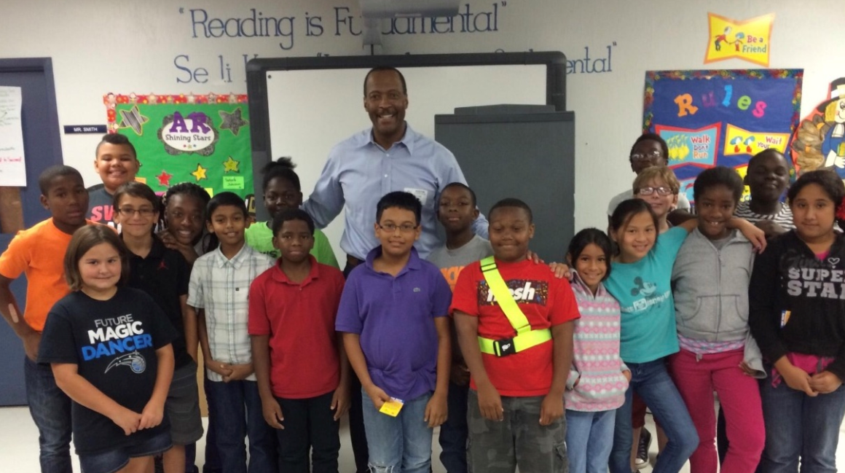
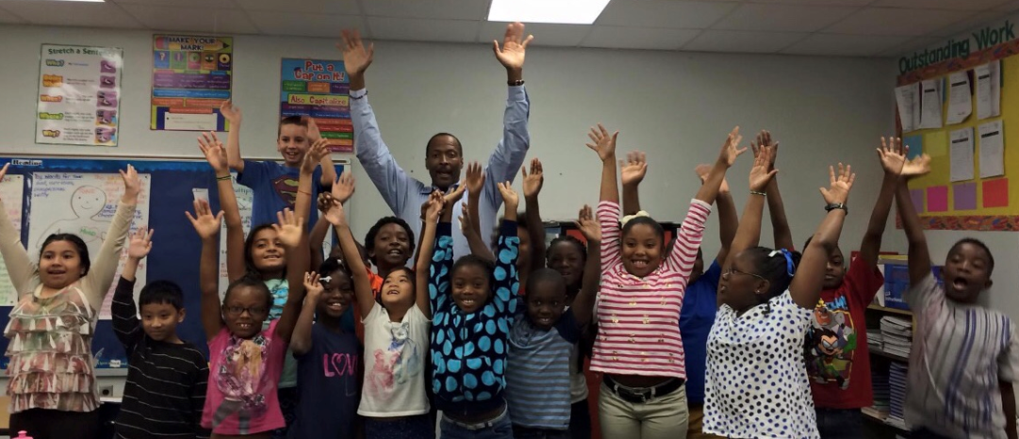
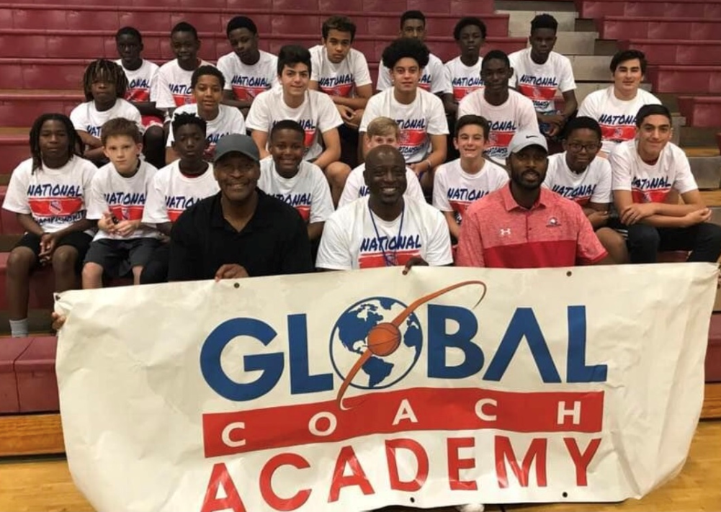
FTA National
Wekiva High School - Apopka, FL
Former NBA Champion Greg Kite & College Coach Dennis Cox
South West Middle School Career Day - Dr. Phillips, FL
Former NBA Champion Sam Vincent

Slide 12
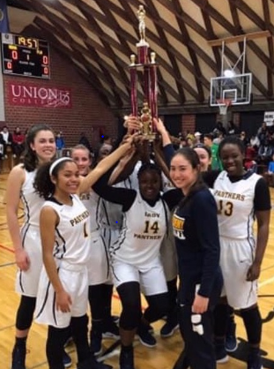
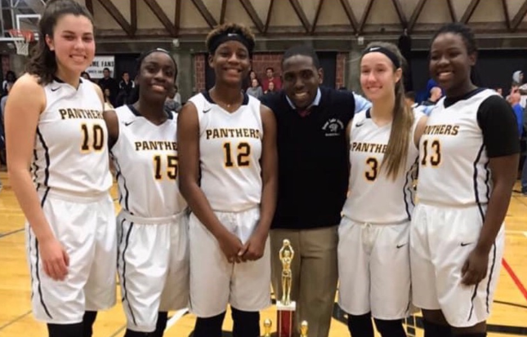
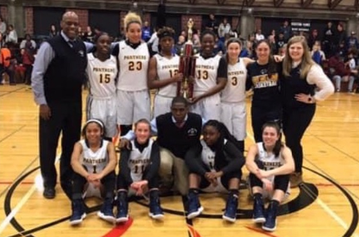
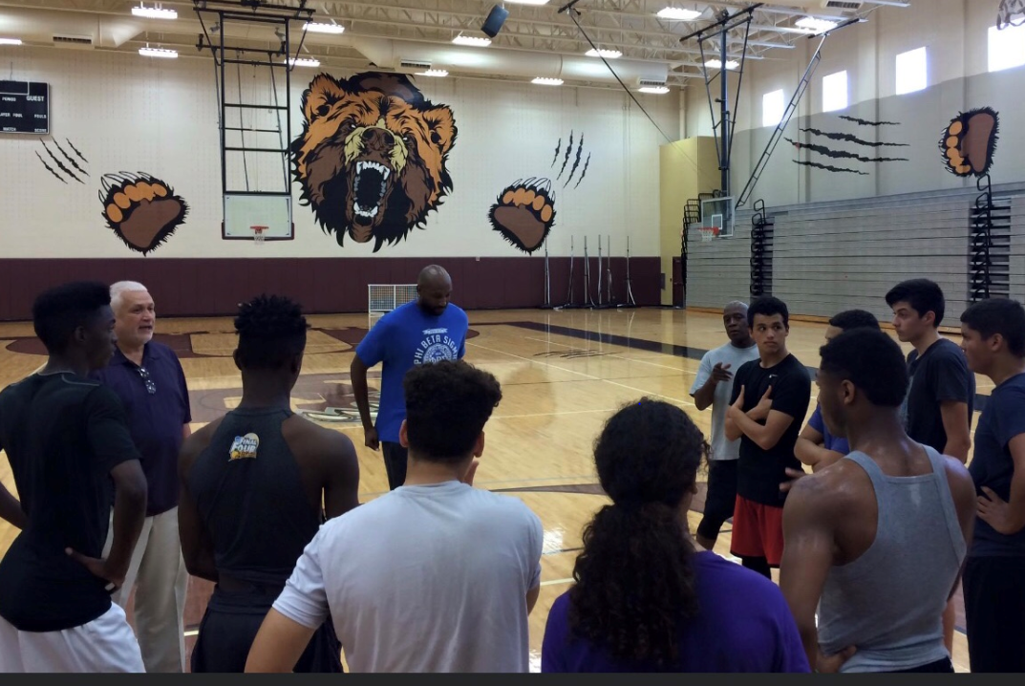
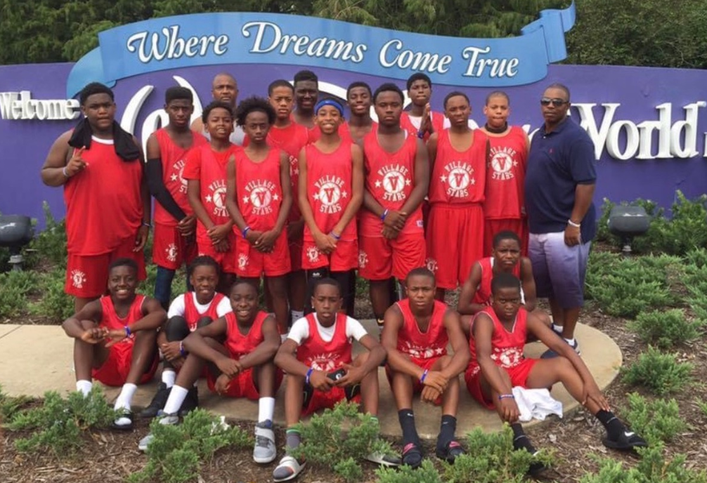
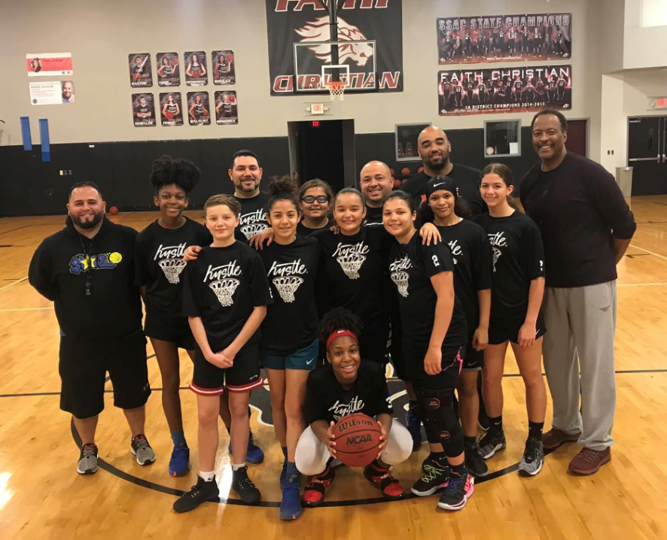
FTA National
Forest Lake Academy - Apopka, FL
Cypress Creek High School - Orlando, FL
Chicago Middle School All Stars in Orlando, FL
Faith Christian Middle School - Orlando, FL

Slide 13
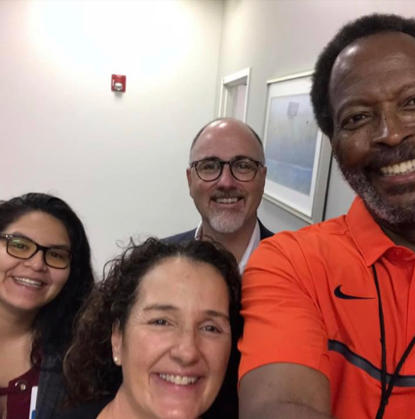
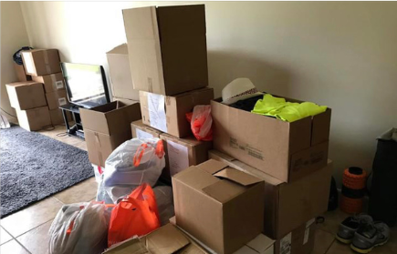
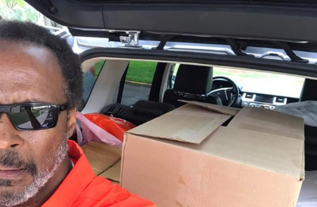
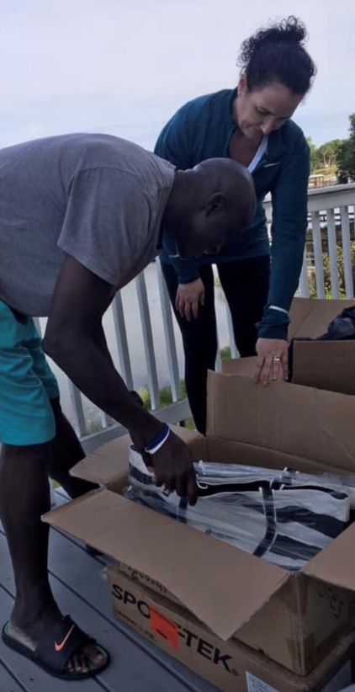
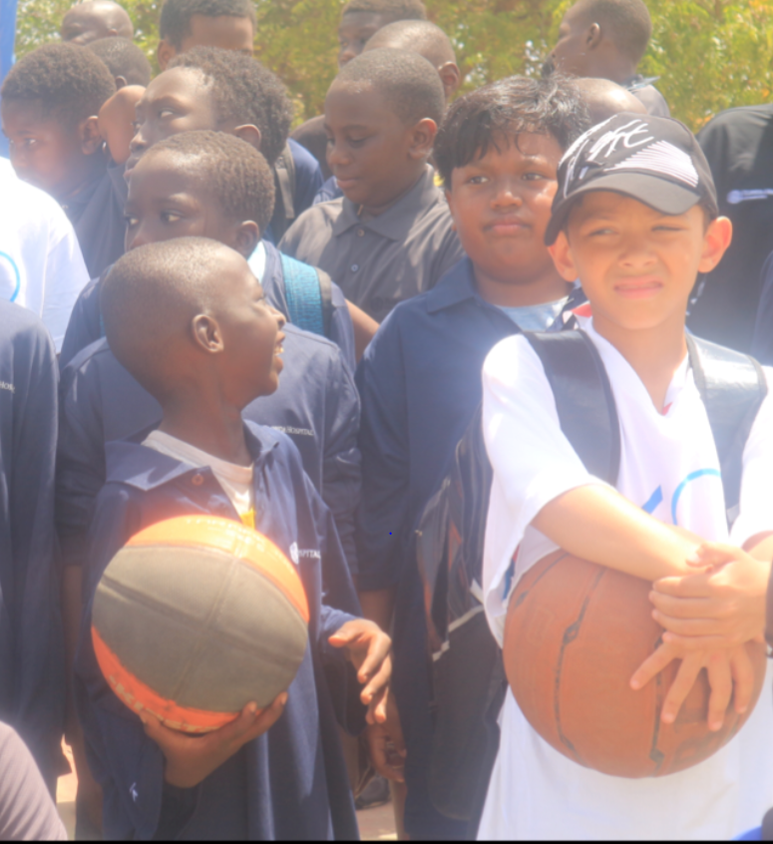
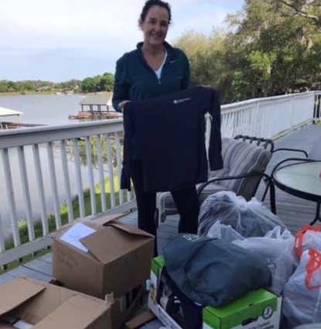
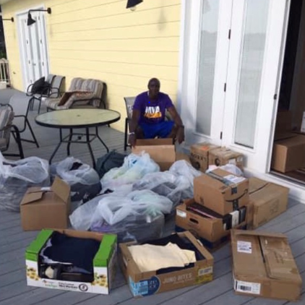
FTA International Donations
Sports Apparel & Educational Material – Dakar, Senegal
2020 Donations
2019 Donations

Slide 14
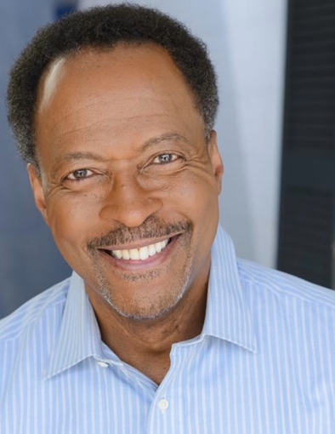
Coaching History
Fundamental Training Academy - Orlando, FL – Founder, 2017-Present
Lake Buena Vista High School - Orlando, FL – Consultant Coach, 2024-Current
Poinciana High School - Kissimmee, FL – Consultant Coach, 2019-2024
Cypress Creek High School - Orlando, FL – Asst. Coach, 2014-2017
Montverde Academy - Montverde, FL – Asst. Varsity Boys Basketball/JV Head Coach/Strength and Conditioning Coach, 2006-2008
Oak Ridge High School - Orlando, FL – 2007-2008
Freedom High School - Orlando, FL – Head Coach, 2003-2006
Seminole Community College - Sanford, FL – Asst. Coach, 1999-2000
Lake Highland High School - Orlando, FL – Asst. Coach, 1999-2003
Parkland College - Champaign, IL – Asst. Coach, 1985-1987
Lewis University - Romeoville, IL – Asst. Coach, 1988-1991
University of Illinois - Champaign, IL – Grad. Asst. Coach, 1985-1987
Bundaberg Bulls - Queensland, Australia – Head Coach, 1994-1998
Levi Cobb
Founder

Slide 15
Fundamental Training Academy
Board Members
Levi W. Cobb – Founder
Robert Williams Jr. – Attorney at Law, Registered Agent
Antwan L. Burks – Rise and Shine Food & Out Reach Center, Co-Founder
K. Bethel Harris – VanPelt Mason Holdings, LLC., Chief Strategy Officer
Jimmy King - Kellanova Corporation, Regional Marketing Manager
Mark Scott – Retired Law Enforcement Officer
Tony Scott – Vision Tech, Owner Founder
Daryl Hardy – CEO, Gemini Foundation
Thomas K. Cobb – TrueBlue, Inc., Area Manager

Slide 16




FTA Worldwide
Chicago, Illinois
Helsinki, Finland
Champaign, Illinois
Atlanta, Georgia
Orlando, Florida
Dakar, Senegal
Banjul, Gambia
Harare, Zimbabwe
Gaborone, Botswana
Queensland, Australia
Camps/Clinics
Equipment/Gear
FTA conducted camps/clinics and shipped equipment/gear

Slide 17
FTA Camp Future Locations
Canada
Southern France
New York
California
Nigeria
Jamaica
Zimbabwe
Botswana
South Africa

Slide 18
CORPORATE FUNDING
Introduction
We are excited to present an incredible opportunity to be part of a transformative initiative — The Fundamental Training Academy — united by the goal of empowering youth through sports, education, and life skills. This annual program aims to foster talent, develop character, and create sustainable pathways for young athletes across United States, Africa, and Europe leveraging the power of basketball to inspire and build future leaders.
Overview of the Program
Name: Fundamental Training Academy
Type: Annual sports education and leadership development program
Location: United States, Africa, and Europe with planned expansion to other continents
Target Audience: Boys and girls, middle school to college age
Core Focus: Athletic Skill Development, De-escalating Violence, NCAA Division I and Division II Recruiting, NIL, Sports Agents, Technical School Training/Certification (Carpentry, Plumbing, IT, Engineering, Electrical, Automative Engineering)

Slide 19
Goals and Objectives
  Strengthen the FTA brand as a global youth development leader
  Develop multi-sport facilities including basketball courts, football fields, and training centers
  Promote athletic opportunities abroad—U.S., Africa Europe, and beyond—for student athletes
  Organize symposiums tackling critical issues
  Foster partnerships that can sustain ongoing programs and facility development
Why Support This Initiative?
  Developing Student Athletes to become Future Leaders: Harnessing sports to promote education, discipline, and community responsibility.
  Global Impact: Expanding the reach of student athletes into international sports and educational opportunities.
  Corporate Social Responsibility: Position your brand as a leader in youth empowerment, education, and community development.
  Brand Visibility: Increased exposure through national and international media channels, events, and social media platforms.

Slide 20
Targeted Markets & Expansion Cities
Domestic (U.S.): Chicago, Orlando, Atlanta; future cities include New York, Los Angeles
International (Africa & Europe): Dakar, Gambia, Helsinki, Rome; future cities include France, Greece, Queensland
Partnership & Sponsorship Opportunities
Corporate Sponsorships
  Support for program operations, facility construction, and scholarships
  Branding presence on uniforms, facilities, and promotional materials
Sports Apparel, Equipment, & Nutrition
  Provide sports gear, apparel, shoes
  Drinks and nutrition brands to support athletes during training and competitions
Transportation & Travel
  Airlines (United, Emirates, Delta): Support for athlete travel to international competitions and scholarship opportunities
Media & Digital Engagement
  Television broadcasting, social media campaigns, radio, podcasts
  Highlight success stories, program impact, and partnership visibility

Slide 21
Next Steps & How to Get Involved
Join us in shaping the future of student athletes through this dynamic initiative. Opportunities range from sponsorship and donations to equipment provision and media partnerships. Together, we can make a lasting impact—empowering young through sport, education, and life skills.
Contact us for a detailed partnership proposal and to discuss tailored sponsorship packages.

Slide 22

Fundamental Training Academy… connecting the world one game at a time!
“more than just a game”

Slide 23
Fundamental Training Academy
Contact Information
LEVI COBB
407-488-3393
VICOBB3206@GMAIL.COM
FUNDAMENTAL TRAINING ACADEMY

